Slide 1
Fake News Classifier
project by:
Carlos Castano
DeVante Frederick
Manasa Sai Challa

Slide 2
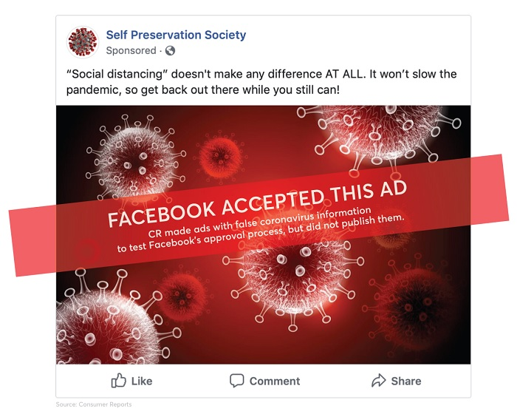

Abstract
The rate at which information can be accessed has
increased exponentially over the past century
Misinformation such as fake news or propaganda can now be spread faster than ever.
This could impact politics, public figures, businesses and general health.
different AI algorithms and models that can detect and flag such information as fake news.

Slide 3
Baseline
We used a subset of the data to work with and this data was sourced from Reddit.
These multimodal samples are used for our baseline experiments and for error analysis.
The samples in our dataset contain both text and images.
The 3-way classification determines whether a sample is completely true, the sample is fake and contains text that is true (i.e. direct quotes from propaganda posters), or the sample is fake with false text.

Slide 4

Image Classifier

Slide 5
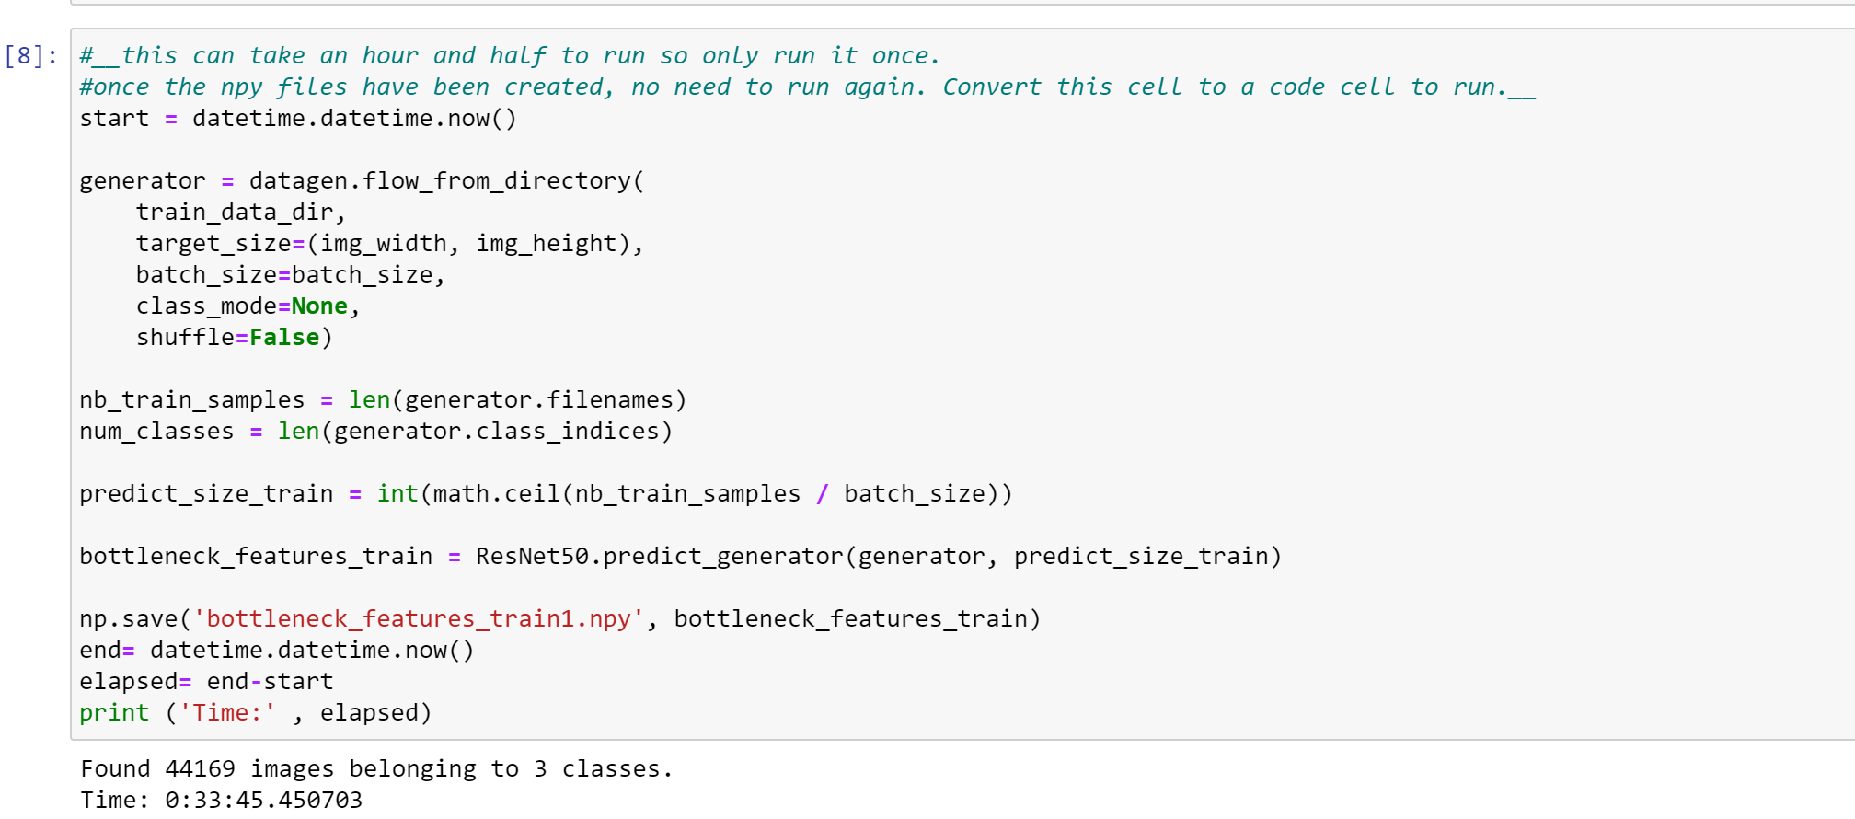
Creating Weights with ResNet50
First step in creating the image classifier we created weights and used ResNet50 for transfer learning.
ResNet50 was used because it contains 50 convolutional layers, and is appropriate when working with larger image files.
The weights are saved into bottleneck files we created.

Slide 6
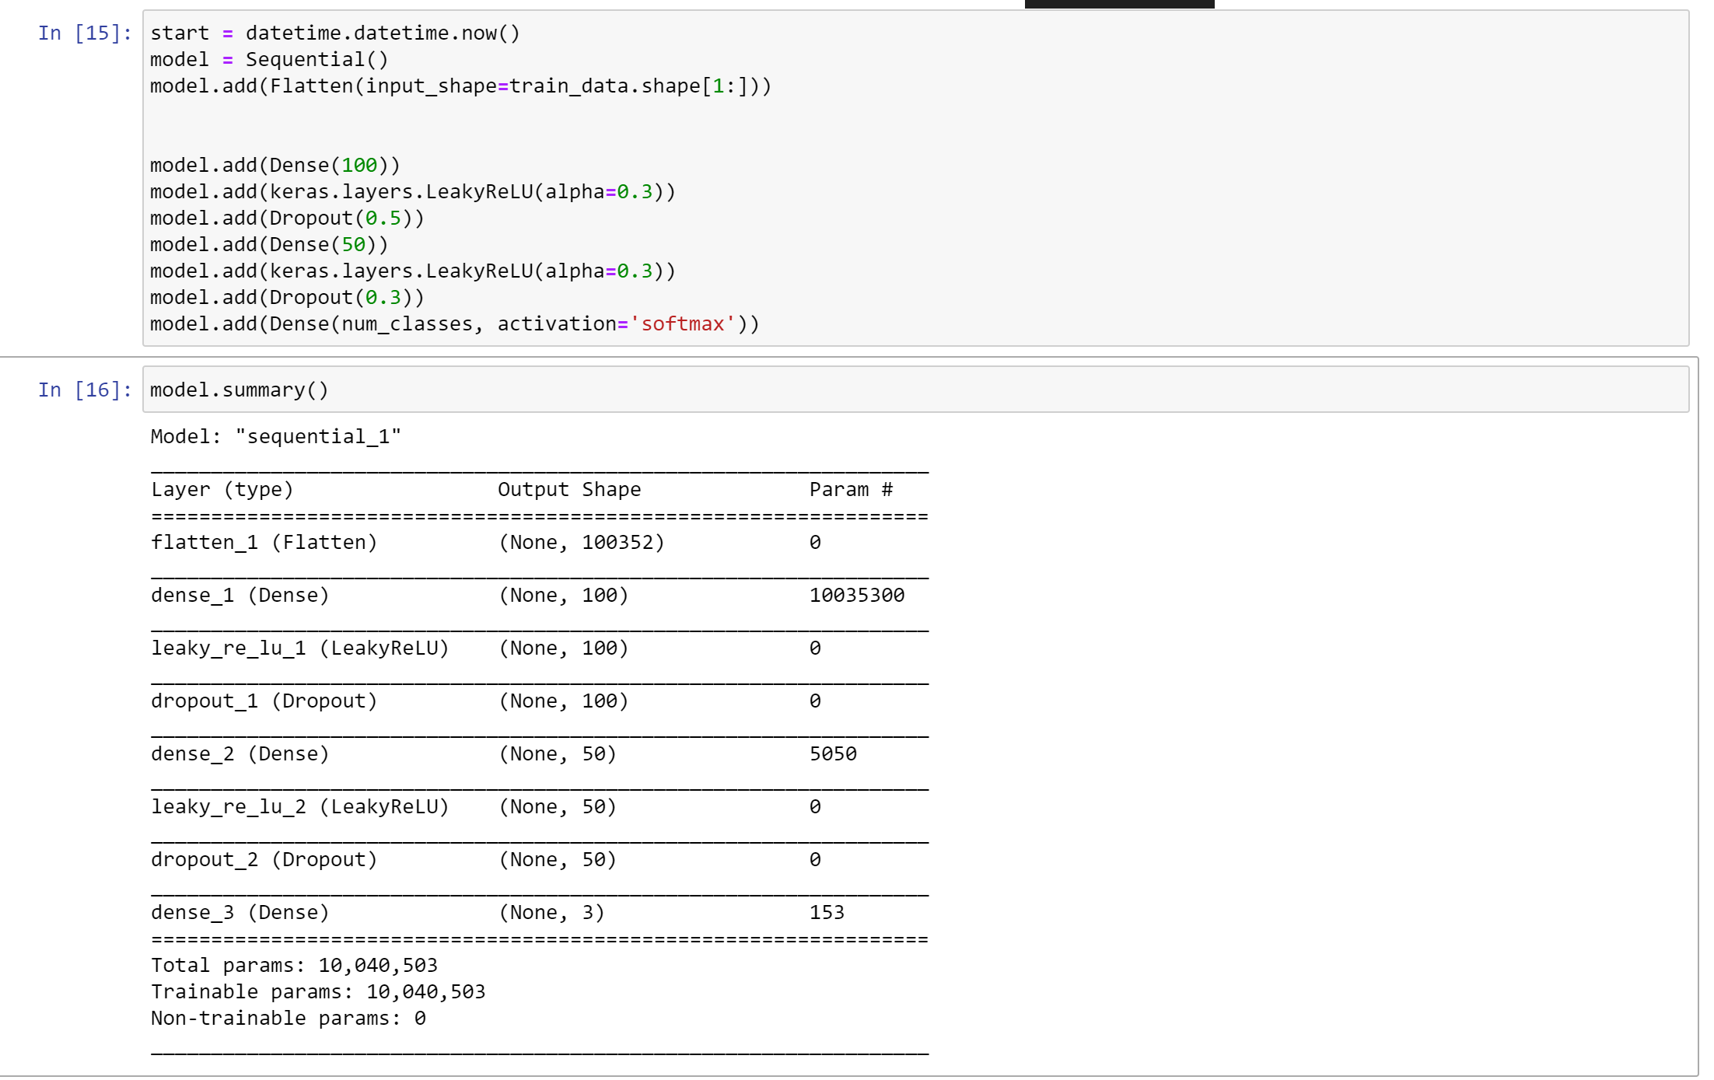
Creating CNN
First we created a sequential model that we flatten our data and added 3 hidden layers.
Since we performed multilabel classification, the final activation had to be softmax.

Slide 7
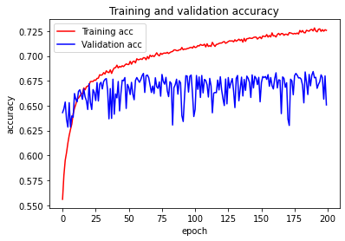
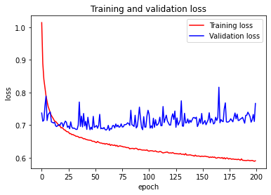
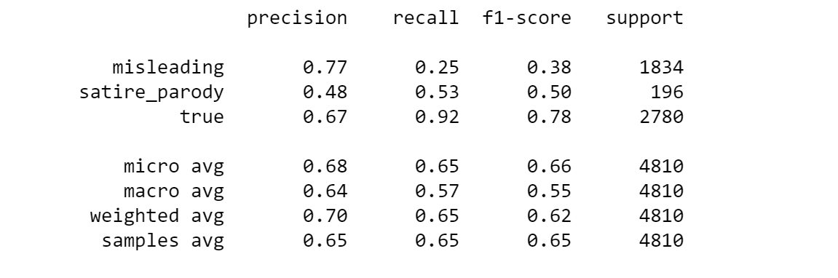
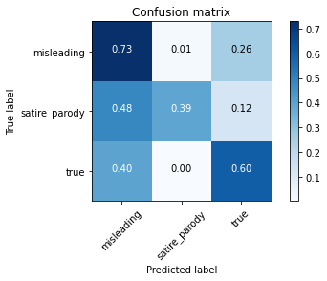
Data and Experiments
The data here shows that training data is fitting properly
The Confusion Matrix show the strength and weaknesses between the classifiers ability to differentiate between the different classifications

Slide 8
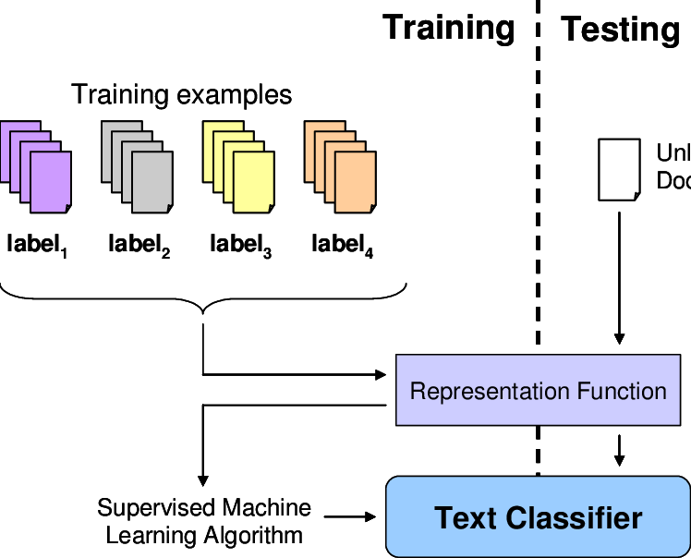
Text Classifier

Slide 9
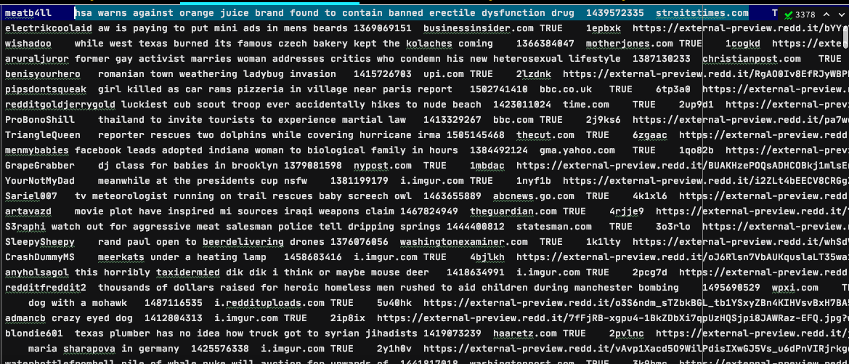
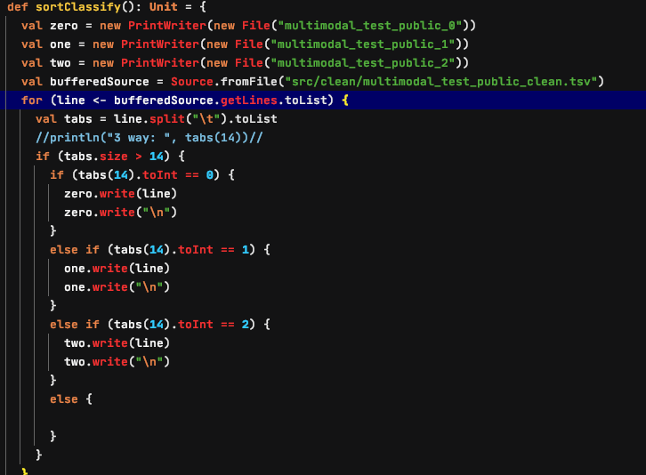
Extracting Text from TSV files
In order to classify the text we needed to extract and separate each file based on its classification value.
Each sentence needs to be extracted by its location in the line separated by ‘\t’ (tab)
The model will then take this sentence and tokenize it for processing

Slide 10
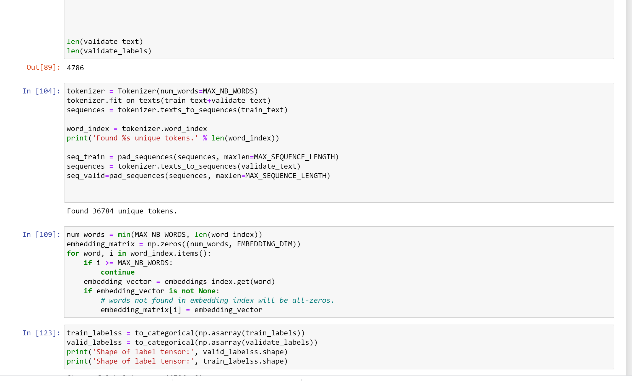
Tokenizing Sentences
The sentences needs to be tokenized
This marks the beginning and end of the sentence
Numerical values can the be hashed from the sentence and put into a 2d matrix

Slide 11
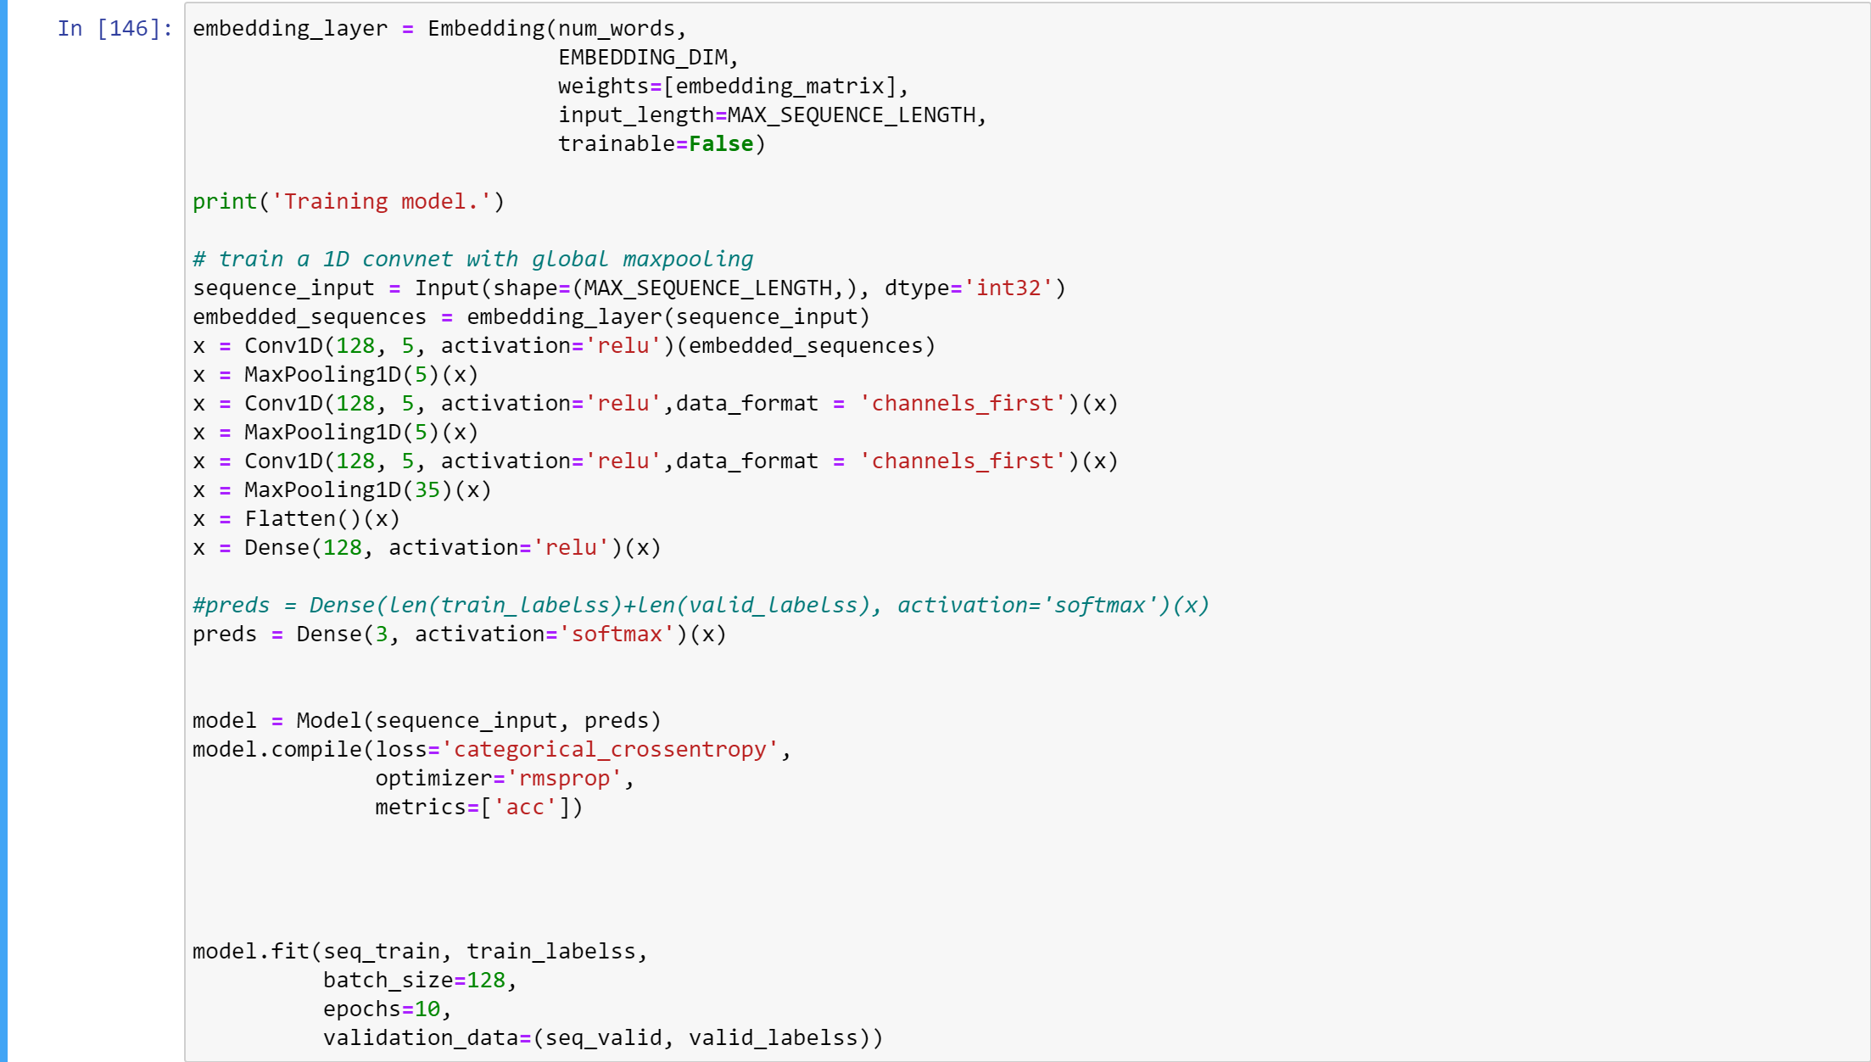
CNN for Text Classifier
CNN for Text Classifier used word2Vec for embeddings, and a custom CNN architecture of 3 hidden layers.

Slide 12
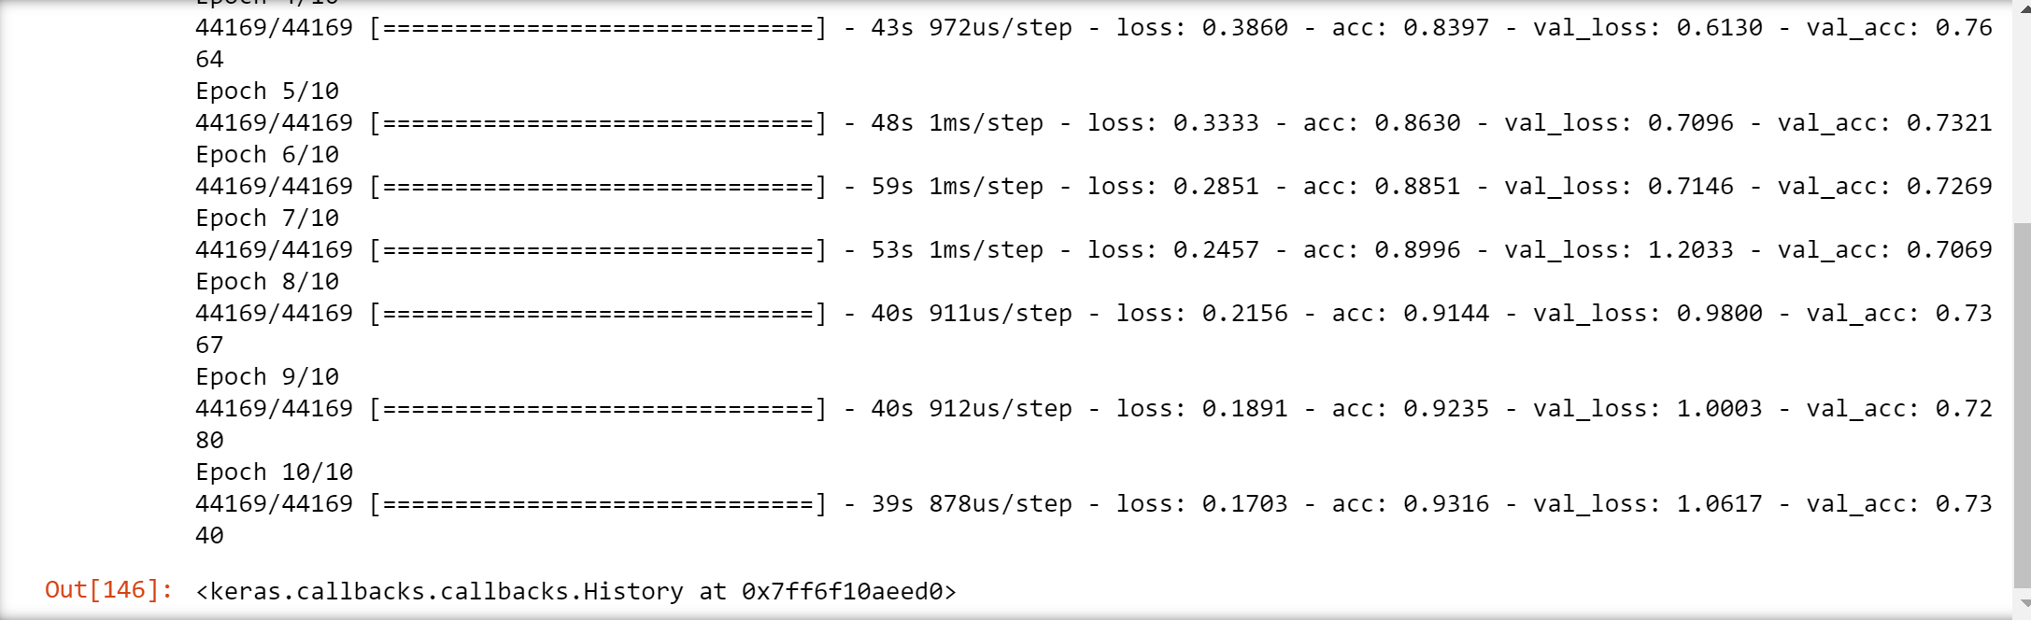
Text Classifier results
Text Classifier showed a text accuracy of 73%, which is higher than the Image Classifier.
This is expected as Fakeedit experienced the same results in their research.

Slide 13
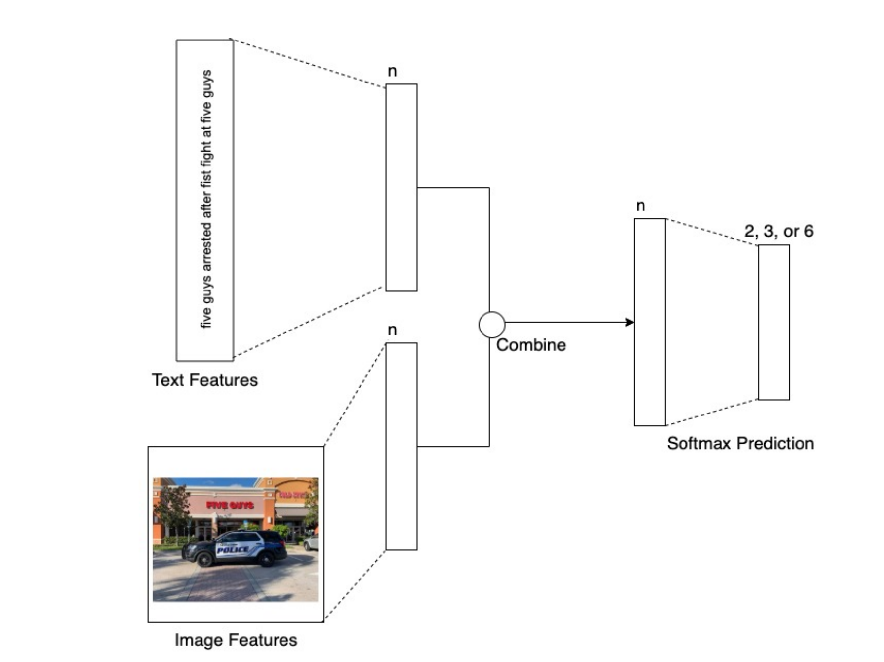
Multimodal Model

Slide 14
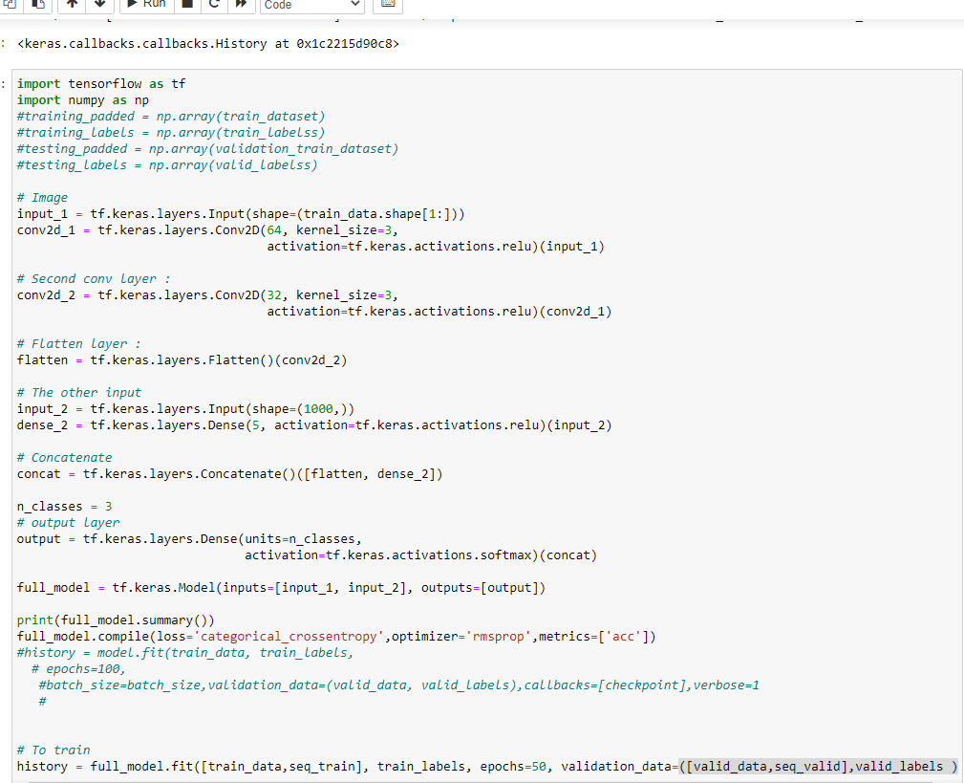
Concatenate
Using a final layer, we concatenate the two inputs of image and text.
This Concatenation of the two inputs leads two a multimodal classification architecture.

Slide 15
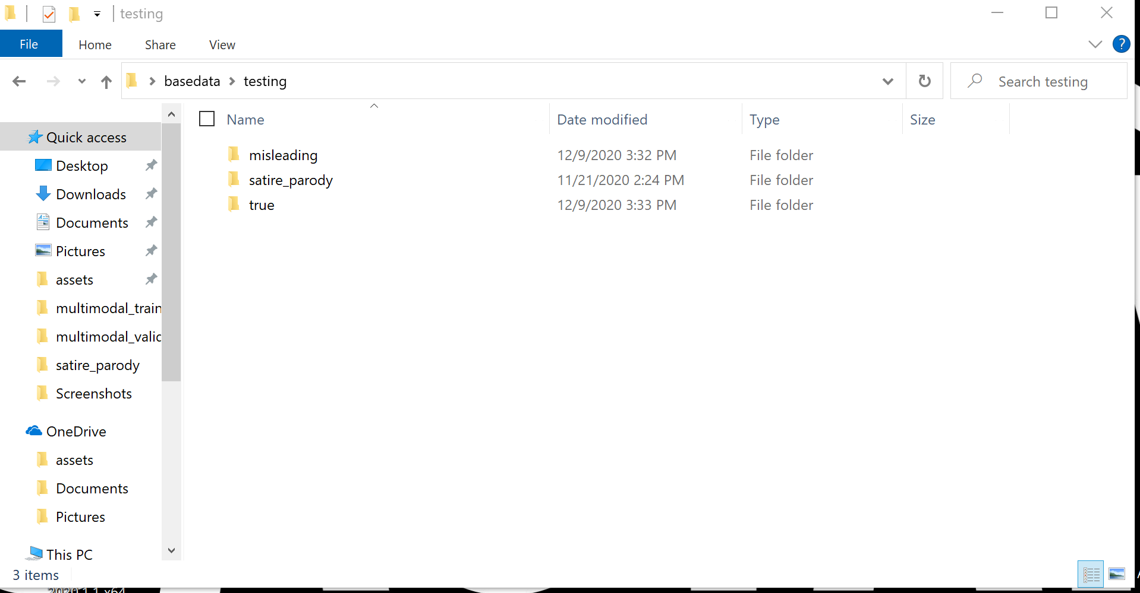
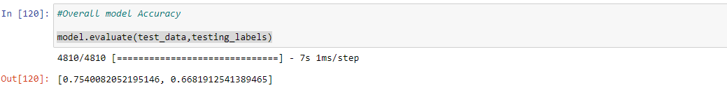
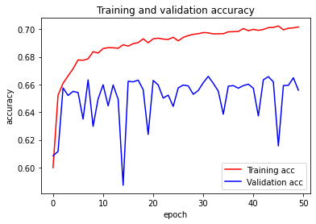
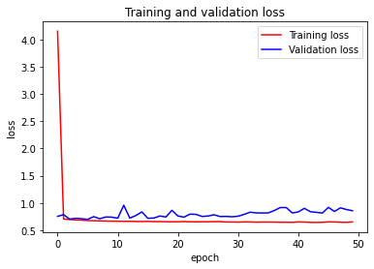
Multimodal Results /Demo
4810 new image/text sets were used to evaluate overall system accuracy.
Out of the 4810 image/texts sets, 3,222 image/text sets were labeled correctly by the multimodal classifier.

Slide 16
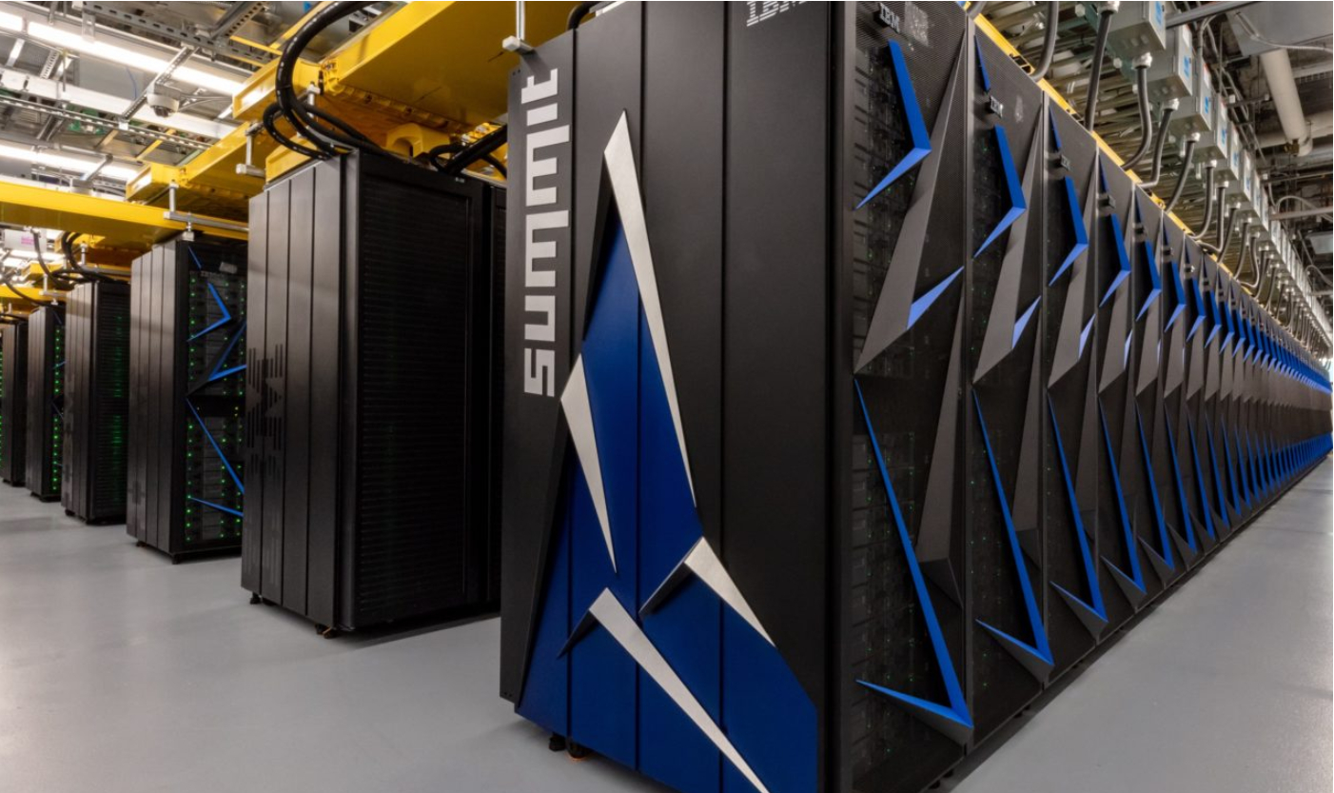
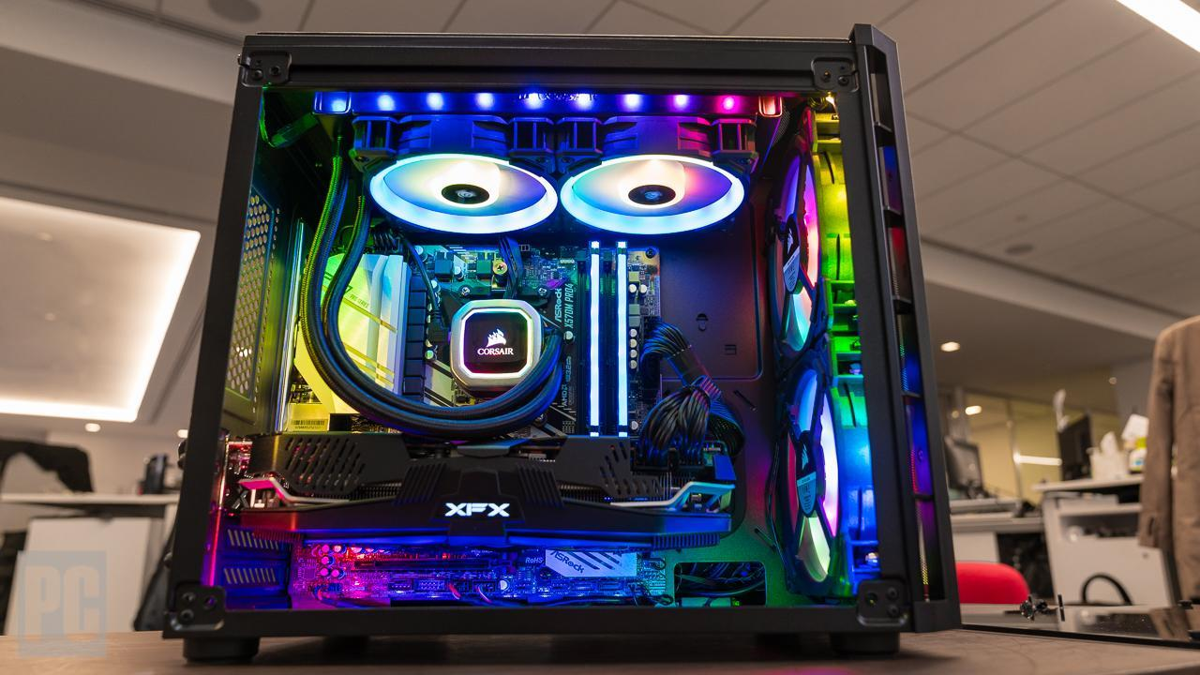
Problems and Issues
Proper hardware and system requirements are necessary
Without this, processes and runtimes can become exponentially longer and worse.
During this project our hardware was an extremely limiting factor in development
This would eventually impact us on our baseline extension
An Intel i9 processor can struggle with some of the basic ML libraries
Super computers are required to be able to compute and process large amounts of data
These super computers can cost up to $40,000 USD and more

Slide 17
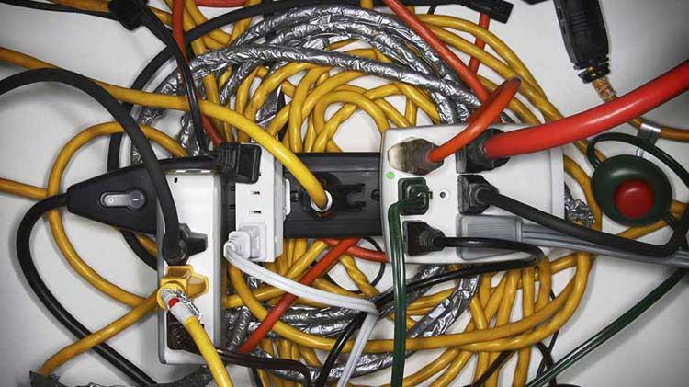
Baseline Extension

Slide 18

Data Augmentation
Data Augmentation is an effective way of achieving higher accuracy with limited hardware constraints.
Multiple different methods can be used to achieve higher accuracy
In order to assure maximum efficiency, methods being used should align with what data is be classified

Slide 19
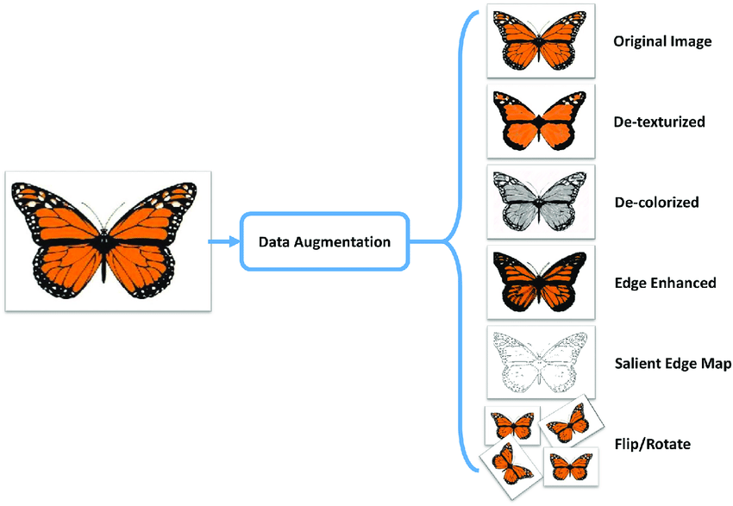
Data Augmentation Methods
Flip/Rotation - Rotating the image on its axis and flipping it
Scale - Making the image larger or smaller
Crop - Focusing on a individual section of the image
Translation - Moving the primary aspect of the image within its borders
Reflect - Reflecting the image along its designated axis boundary

Slide 20
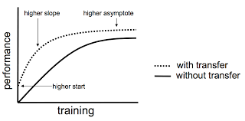
Transfer learning
Transfer learning is another way to increase the performance of a model without the need for powerful hardware or large datasets
This utilizes the “knowledge” of a pretrained model
This model will be pre-trained on a substantially larger data set than the one we have, making its performance better.

Slide 21
Citations References
Jain, Sarthak. “NanoNets : How to Use Deep Learning When You Have Limited Data.” Medium, NanoNets, 27 Mar. 2018, medium.com/nanonets/nanonets-how-to-use-deep-learning-when-you-have-limited-data-f68c0b512cab.
Alammar, Jay. “A Visual Guide to Using BERT for the First Time.” A Visual Guide to Using BERT for the First Time – Jay Alammar – Visualizing Machine Learning One Concept at a Time., jalammar.github.io/a-visual-guide-to-using-bert-for-the-first-time/.
Gandhi, Arun. “Data Augmentation: How to Use Deep Learning When You Have Limited Data.” AI & Machine Learning Blog, AI & Machine Learning Blog, 6 Aug. 2019, nanonets.com/blog/data-augmentation-how-to-use-deep-learning-when-you-have-limited-data-part-2/.
Github: https://github.com/DeVante018/Fake_News_Classifier

